Slide 1
Game Rentals Windows Application
Developed by : Bogdan Teodorov.

Slide 2

Introduction
Game Rentals is a Windows application designed to let
gamers enjoy recent and popular releases for affordable
prices on rental basis.

Slide 3

User-Friendly Game Browsing
Users can easily explore the extensive collection of games available for rent.
Intuitive interface for a seamless browsing experience.

Slide 4

Efficient Rental Process
Simple and straightforward game rental process for users.
Users can rent games and track the due date and rental status in one click .

Slide 5

Comprehensive Game Details:
Detailed game information, including title, genre, release date, description, rental price, and rating.
Provides users with all the necessary details to make informed rental decisions.

Slide 6

Administrator Tools:
Admins can easily add new games and users to the database.
Edit and manage game details for accurate information.
Monitoring tools for rentals and returns.

Slide 7

Rental Expiry Management:
Strict adherence to due dates for game returns.
Overdue rentals are handled with an automated system for additional charges.

Slide 8

Age and Rate Requirements:
Age verification for customers (18 years or older) for specific rental rates.
The "Rate" column in the Games table corresponds to the allowed rental rate.

Slide 9
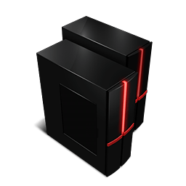
Scalability:
Designed to handle a growing collection of games and an increasing number of users.
Scalable infrastructure to support future expansions.

Slide 10

Future features in next versions
Robust search options based on title, genre, or release date.
Notifications for due dates and other relevant updates.

Slide 11
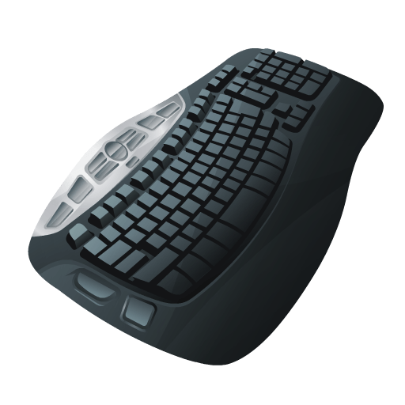
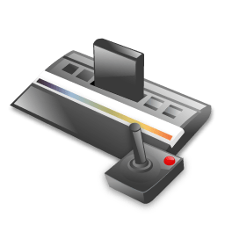

Thank you for your attention

